Slide 1

RMD Sinhgad School of Engineering Department of Computer Engineering “Movie Recommendation System Using Machine Learning”
Presented By:
Viraj Bhise
Guided By:
Grishma Bobhate

Slide 2
Contents
Introduction
Literature survey
Architecture of the system
Technology used in the system
Types of Approach
Analytical Study
Real world Applications
Future Scope
Conclusion
Bibliography

Slide 3
Introduction
Recommendation systems produce a ranked list of items on which a user might be interested, in the context of his current choice of an item.
Subclass of Information filtering system that seek to predict the ‘rating’ or ‘preference’ that a user would give to them.
Helps deciding in what to wear, what to buy, what stocks to purchase etc.
Applied in variety of applications like movies, books, research articles.
Recommendation systems has mainly two elements Item and User.

Slide 4
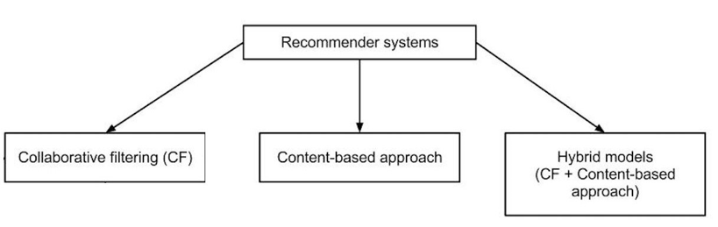
Types in System
Problem Statement : Recommend content to user which is unknown or similar to watching history or based on previous rating for content .

Slide 5
Movie Recommendation System
Content Based: The recommendation system recommends other movies which are similar to that selected movie.
f(movie) → {movies}
Collaborative: The recommendation system recommends movies which are rated highly by the similar users.
f(movies, user) → {movies}
3 . Hybrid Approach : Hybrid recommender systems combine two or more recommendation strategies in different ways to benefit from their complementary advantages.

Slide 6
Literature Survey
Sr No | Paper title and author name | Year | Short description
1 . | Francesco Ricci and Lior Rokach and Bracha Shapira,, Recommender Systems Handbook, | 2011 | Provides early stage information about recommendation systems .
2. | Beel, J.; Langer, S.; Genzmehr, M.; Gipp, B.; Breitinger, C. (October 2013). Recommender system evaluation research paper | 2013 | Provided analytical survey for recommendation systems
3. | Karlgren, Jussi (October 2017). "A digital bookshelf: original work on recommender systems | 2017 | Book for study of recommended systems
4. | D.H. Wang, Y.C. Liang, D.Xu, X.Y. Feng, R.C. Guan(2018), "A content-based recommender system for computer science | 2018 | Demonstrated how content based recommender system works .

Slide 7
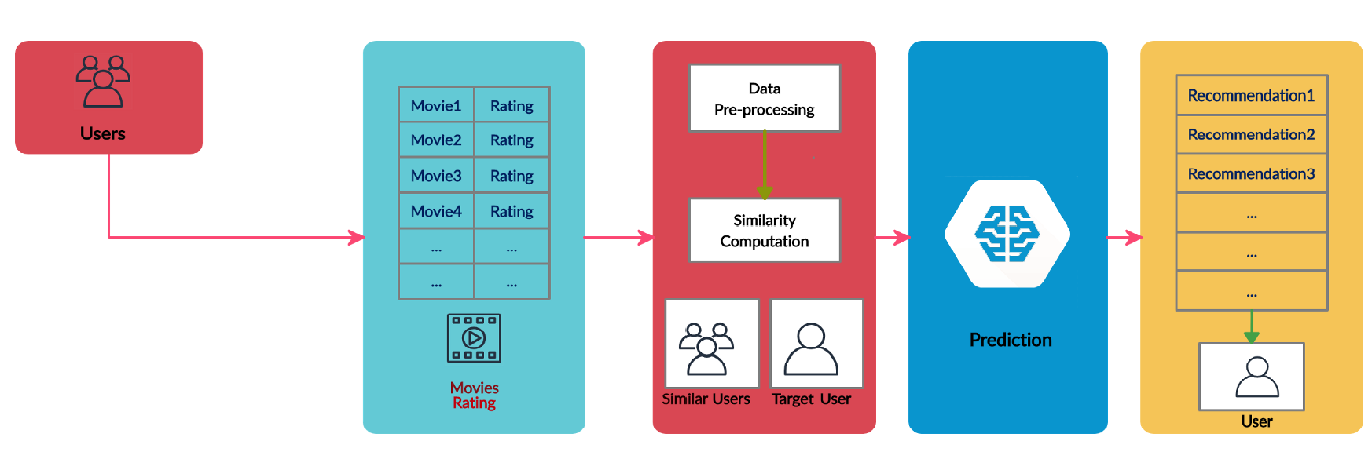
Architecture of the system

Slide 8
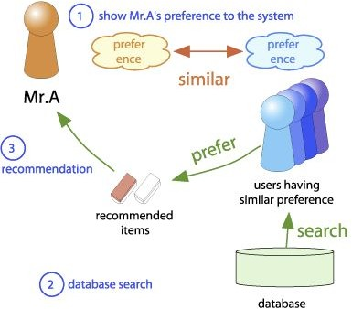
Collaborative Filtering
Collaborative Filtering system maintains a database of many users’ ratings of a variety of items.
Makes use of the user data, ignoring content / item data.
Almost all existing commercial recommenders use this approach (e.g. Amazon, Facebook, LinkedIn).

Slide 9
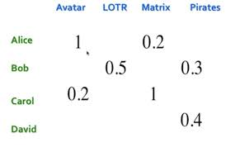
Similarity Measures
Utility Matrix: Users have preferences for certain items and these preferences must be discovered from the data. The data is represented as a utility matrix, a value that represents the rating given by that user for that item and is given for each user-item pair.
Pearson Correlation Similarity Measure : Measure of similarity of users or items from the rows and columns of the Utility Matrix.
Advantages:
* Pearson Correlation Measure is easy to interpret.
* Tends to give better results than other measures.
* Normalizes the ratings.
Other Similarity Measures:
Euclidean Distance, Manhattan Distance, Cosine Similarity

Slide 10
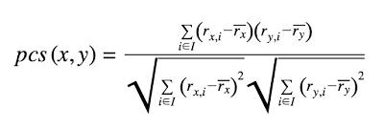
PCS Measure
Let R x i denote the rating given by user x to item i. If I is the set of all items that two users x and y have both rated, then the Pearson Correlation Similarity Measure between the two users is given by:
Where Rx denotes the average rating given by user x to all items. To calculate we only consider items that were rated by the user.

Slide 11
Content Based Filtering
It uses only the item data maintaining a profile for each item. Each user is assumed to operate independently. No need for data on other users.
Considering the attributes or feature of the item, it finds the similarity between items, and recommends the most similar item for an item.
If we consider the content of a movie as director, writer, cast etc., then each of these attribute can be considered as a feature.
Similarity : -
We recommend the items to the users which are very much similar to the rated item by the user.
We define similarity S between objects Oi and Oj as
S(Oi , Oj) = f(A1i , A1j) + f(A2i , A2j) + · · · + f(Ani , Anj)

Slide 12
Hybrid Approach
We attempt to hybridize collaborative filtering and content based recommendation. Item similarity measure used in content based recommendation is learned from a collaborative social network of users.
In content based recommendation every item is represented by a feature vector. The features hold numeric or nominal values representing certain aspects of the item.
A variety of distance measures between the feature vectors may be used to compute the similarity of two items.

Slide 13






Technology used in the system
Platforms :
* Servers hosted on google cloud or aws or any other platform .
* T2.micro and m3 xlarge Ec2 instances .
* Any linux operating system distros , eg Ubuntu 20.04 .
Additional softwares :
* Hadoop
* My SQL
* Mahout
Programming Languages
* python
* Bash
* Java

Slide 14






Real World Applications
Netflix
HULU
Amazon Prime
Youtube
IMDB
Crakle
And many more ….

Slide 15
Future Work
In collaborative filtering, we have a problem of sparsity of data. Very few users actually rate the same movie.
We can use Clustering Algorithms like K-Means to cluster items or users or both based on their attributes.
In the hybrid approach, we can use more features to get better predictions.
Neural Networks and Deep Learning have been all the rage the last couple of years in many different fields, and it appears that they are also helpful for solving recommendation system problems.

Slide 16
Conclusion
Movie recommender system plays a significant role in identifying a set of movies for users based on user interest. Although many move recommendation systems are available for users, these systems have the limitation of not recommending the movie efficiently to the existing users.
In the future work, we plan to develop and improve a new loss function because of the shortcomings of the recommender system algorithm based on ALS model based on the parameter of the best case which has the best value for RMSE using Apache Spark.

Slide 17
References
1. Verma, J. P., Patel, B., & Patel, A. (2015). Big data analysis: Recommendation system with Hadoop framework. In 2015 IEEE International Conference on Computational Intelligence & Communication Technology (CICT). IEEE.
2. Katarya, R., & Verma, O. P. (2016). A collaborative recommender system enhanced with particle swarm optimization technique. Multimedia Tools and Applications, 75(15), 9225– 9239.
3. https://docs.databricks.com/_static/notebooks/cs100x-2015-introduction-to-big-data/module5–machine-learning-lab.html.
4. Wei, J., et al. (2016). Collaborative filtering and deep learning based hybrid recommendation for cold start problem. In 2016 IEEE 14th International Conference on Dependable, Autonomic and Secure Computing,
5. Kupisz, B., & Unold, O. (2015). Collaborative filtering recommendation algorithm based on Hadoop and Spark. In 2015 IEEE International Conference on Industrial Technology (ICIT). IEEE.
6. Zeng, X., et al. (2016). Parallelization of latent group model for group recommendation algorithm. In IEEE International Conference on Data Science in Cyberspace (DSC). IEEE.
7. Ponnam, L. T., et al. (2016). Movie recommender system using item based collaborative filtering technique. In International Conference on Emerging Trends in Engineering, Technology, and Science (ICETETS). IEEE.

Slide 18
THANK YOU !

